Slide 1

Exam AZ-300: Microsoft Azure Architect Technologies Crash Course
Tim Warner

Slide 2
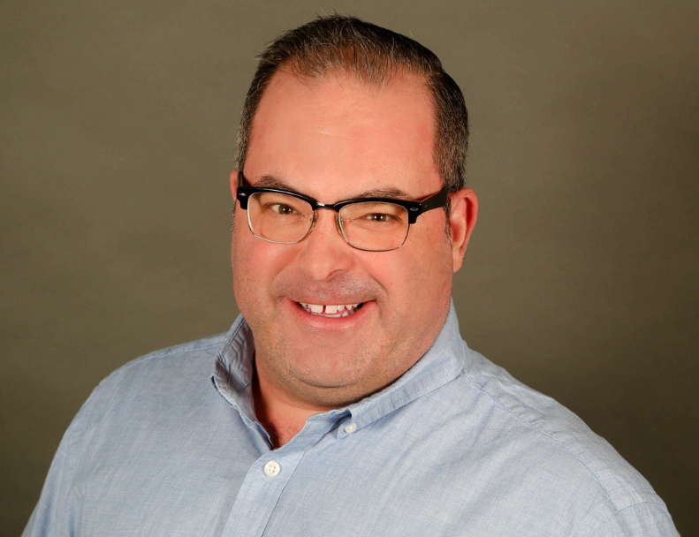

Tim Warner
Based in Nashville, TN, US
MCT, MVP
Twitter: @TechTrainerTim
Badge: timw.info/azarchcert

Slide 3
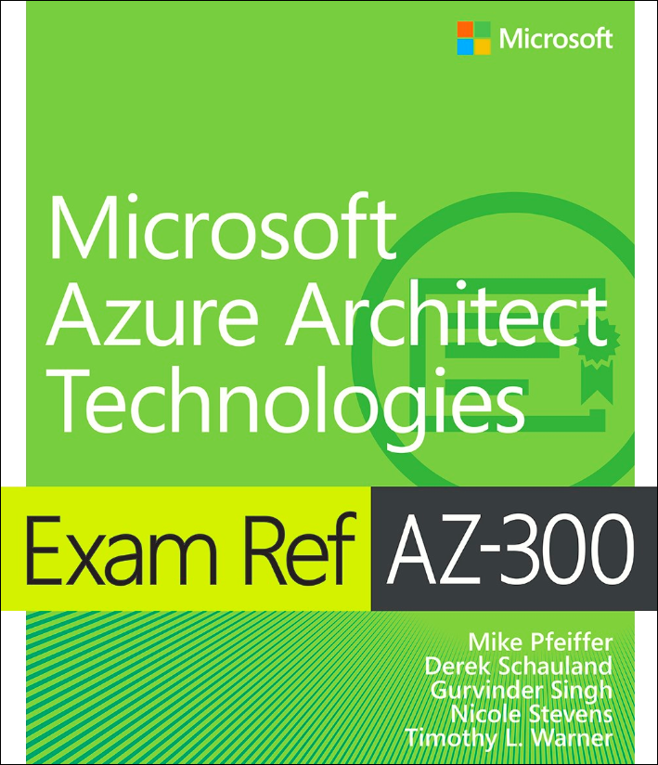
Tim Warner
timw.info/ms300
Safari Books Online

Slide 4
Course Materials
timw.info/az300

Slide 5
Day 1 of 2 Agenda
Introduction
Deploy and configure Azure infrastructure
Resource utilization
Storage accounts
VMs
Virtual networking
Azure AD

Slide 6
Day 2 of 2 Agenda
Azure migration
Serverless computing
Role-based access control
App deployment
Data security
Message-based architecture

Slide 7
Ground rules
AZ-300 is an expert-level certification
You should already know how to deploy and configure Azure resources
This is a "crash course"
We have six hours, and we'll need every minute
Please ask/answer questions and provide feedback in the Q/A panel, not the group chat

Slide 8
Tim's Certification Study Pyramid
Interdependence
Content knowledge
Practical application
Test-taking skills

Slide 9
Module 1: Deploy and Configure Azure Infrastructure

Slide 10
Storage Account Replication
1
3
3
2
LRS
ZRS

Slide 11
Storage Account Replication
1
3
1
3
2
2
GRS – RA/GRS

Slide 12
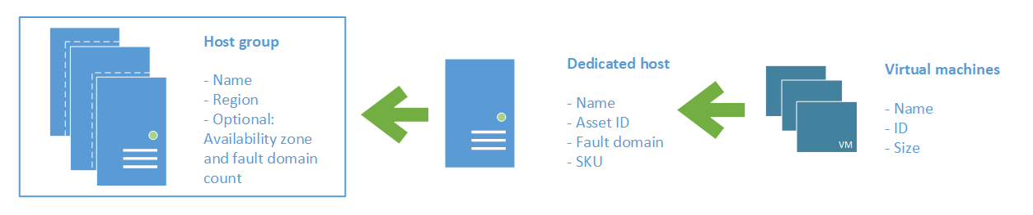
Azure VM Dedicated Host

Slide 13

Availability Set

Slide 14

Availability Zone

Slide 15

Hybrid Networking

Slide 16

VNet Peering

Slide 17

Network Virtual Appliance

Slide 18

Load Balancing

Slide 19

Azure Load Balancer

Slide 20

Application Gateway

Slide 21

Traffic Manager

Slide 22

Front Door Service

Slide 23

Hybrid Identity

Slide 24

Federated Identity

Slide 25
Module 2 Implement Azure Workloads and Security

Slide 26
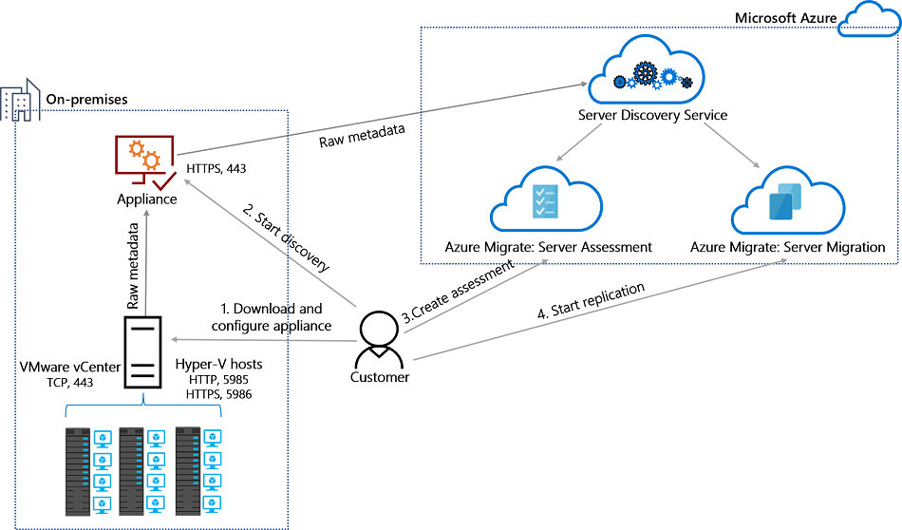
Azure Migrate

Slide 27
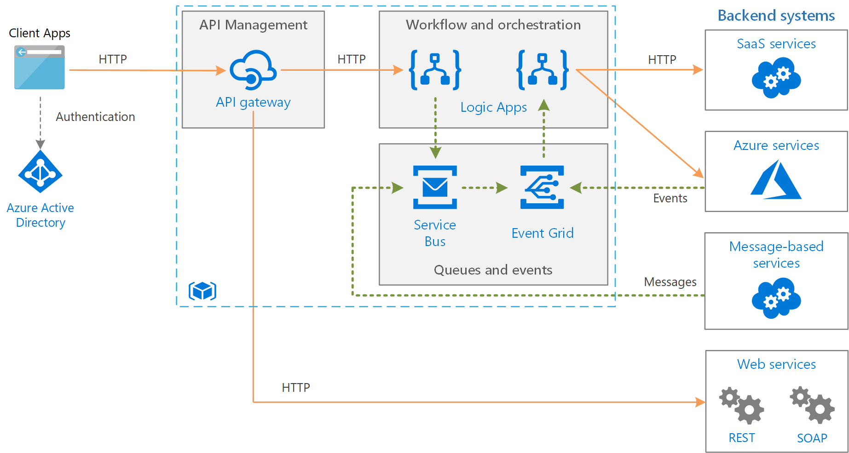
Message-Based Architecture

Slide 28

Azure Management Scopes
/ Tenant Root

Slide 29
Module 3: Create and Deploy Apps in Azure

Slide 30


Docker Container Lifecycle
https://timw.info/3635f

Slide 31
Module 4: Implement Authentication and Secure Data in Azure

Slide 32
Hybrid Identity

Slide 33
Federated Identity

Slide 34

Passthrough Authentication

Slide 35

Seamless Single Sign-on

Slide 36

Always Encrypted

Slide 37
Module 5: Develop for the Cloud and for Azure Storage

Slide 38

VM Scale Sets

Slide 39
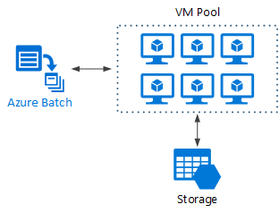
Azure Batch

Slide 40
Module 6: Exam AZ-300 Exam Strategy

Slide 41
Module 6 Learning Objectives
Grasp the content
Acquire the hands-on skills
Master computer-based testing
Comprehend what to expect before, during, and after the exam

Slide 42
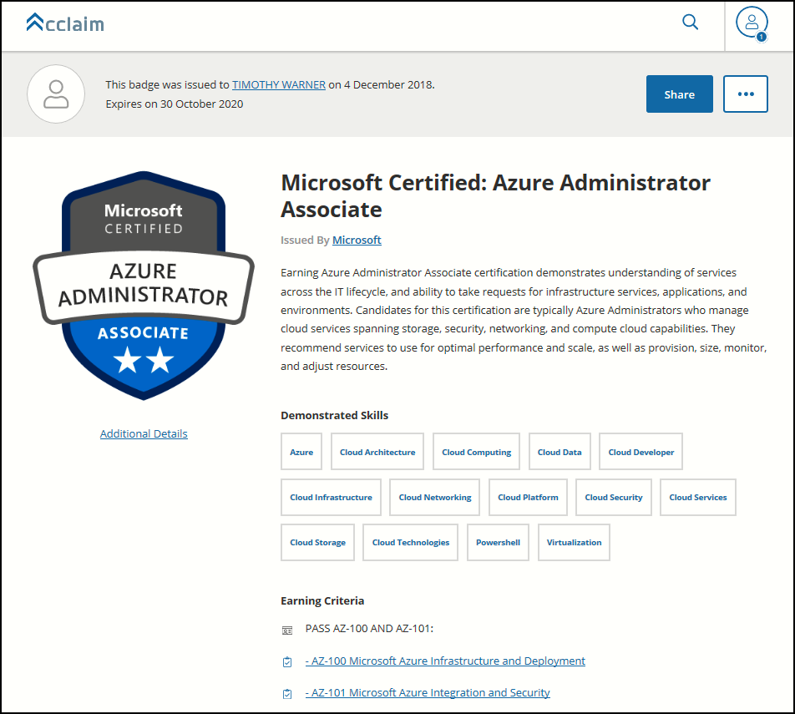
Digital Credentials by Credly/Acclaim

Slide 43
Exam AZ-300 Item Types

Slide 44

Multiple Choice

Slide 45
Repeated Scenario
You need to move an Azure VM to another hardware host.
Solution: You redeploy the VM.
Does this solution meet the goal?
Yes
No

Slide 46

Select and Place

Slide 47

Build List and Reorder

Slide 48

Active Screen/Fill in the Blank

Slide 49

Case Study

Slide 50






Performance-Based Lab

Slide 51
AZ-300 Exam Tips
ARM API suggestion:
60 percent Azure portal
20 percent Azure PowerShell
10 percent Azure CLI
10 percent KQL
Expect to see lots and lots and lots of JSON
Performance-based labs
Open a second tab for shell.azure.com
Don't be afraid to file an item challenge/grievance

Slide 52

Thank you!
Course materials: timw.info/az300
Twitter: @TechTrainerTim
Work: Pluralsight.com
Web: TechTrainerTim.com

